Slide 1
Security Oauth2

Slide 2
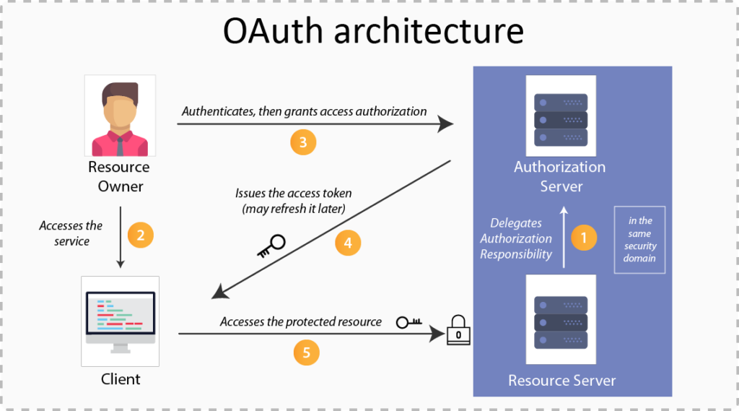

Slide 3
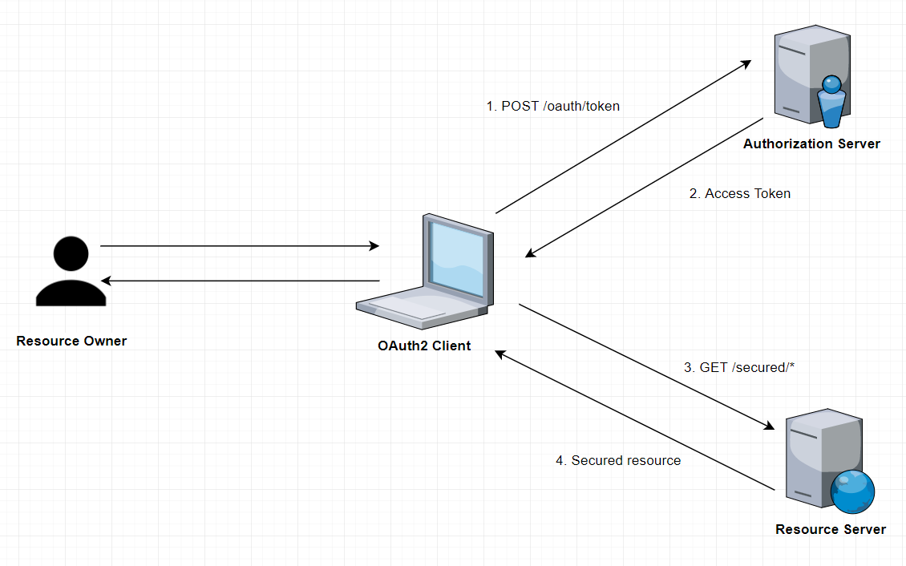
How it Works

Slide 4
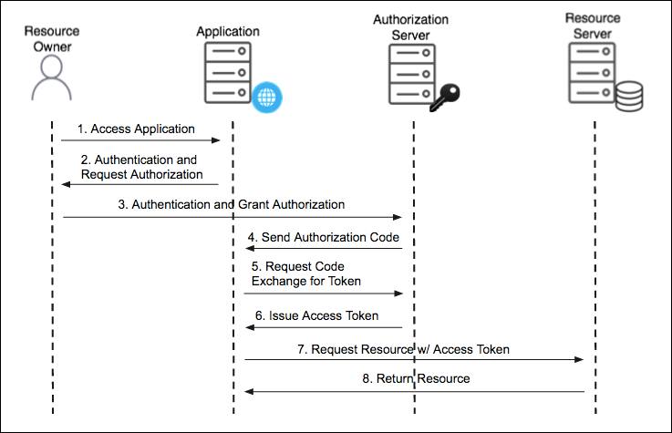
Authorization Code Grant Type

Slide 5
Authorization Code Grant Type
Used by confidential and public clients to exchange an authorization code for an access token.
After the user returns to the client via the redirect URL, the application will get the authorization code from the URL and use it to request an access token.
The GitHub API uses the OAuth Authorization Code grant type
It needs five piece of information
Client ID
Client Secret
Callback URL
Authorization URL
Access Token URL: :

Slide 6
Authorization Code Grant Type
Social logins using Oauth2 have become an industry standard.
Facebook, LinkedIn and Github are OAuth2 login providers
It has revolutionized the way sites share data
Users can quickly access new applications without having to create a new set of credentials.

Slide 7
Authorization Code Grant Type
Authorization Server
Client Application can use the authorization code grant to obtain an access token from GitHub
Resource Server
It uses the access token to ask GitHub for permitted personal details like login ID and name.
It Decodes the token checking if it gives the app permission to access the user’s details.
Inserts the user details into the Spring Security context

Slide 8
Using Git Hub
Navigate to https://github.com/settings/developers
create a New OAuth app under the OAuth Apps left menu.
Fill in the Authorization callback URL field to include the redirect URI to your app: http://<your-domain>/login/oauth2/code/github
Click on Register Application
Copy the client ID and client secret to be used Later

Slide 9
OAuth2 Client
<dependency>
<groupId>org.springframework.boot</groupId>
<artifactId>spring-boot-starter-oauth2-client</artifactId>
<version>2.3.3.RELEASE</version>
</dependency>

Slide 10
Controller
@RestController
public class AppController {
@GetMapping("/")
public String home() {
return "home";
}
@GetMapping("/secured")
public String classified() {
return "Secured Resource";
}
}

Slide 11
Security Config
oauth2Login()
similar to httpBasic() and formLogin()
Will be used to display an auto-generated login page for login provider
http
.authorizeHttpRequests(authorize -> authorize
.requestMatchers("/").permitAll().anyRequest().authenticated() )
.oauth2Login(oauth2Login -> oauth2Login
.loginPage("/oauth2/authorization/github")
.defaultSuccessUrl("/")
).logout(logout -> logout
.logoutSuccessUrl("/") .permitAll()
);
return http.build();

Slide 12
Google as an OAuth Provider
Visit the Google Cloud Console at console.cloud.google.com.
Set up the OAuth 2 consent screen
Go to the Credentials section and create a new OAuth 2 client ID.
Select "Web application" as the type, and enter a name for the application.
Add an authorized redirect URI: http://localhost:8080/login/oauth2/code/google.
Click "Create" to obtain your client_id and client_secret for your properties file.
Testing the Application
Visit http://localhost:8080/ in your browser.
Will be prompted to log in via form login or the OAuth providers configured
Log in google providers
Redirected to the secured page.

Slide 13
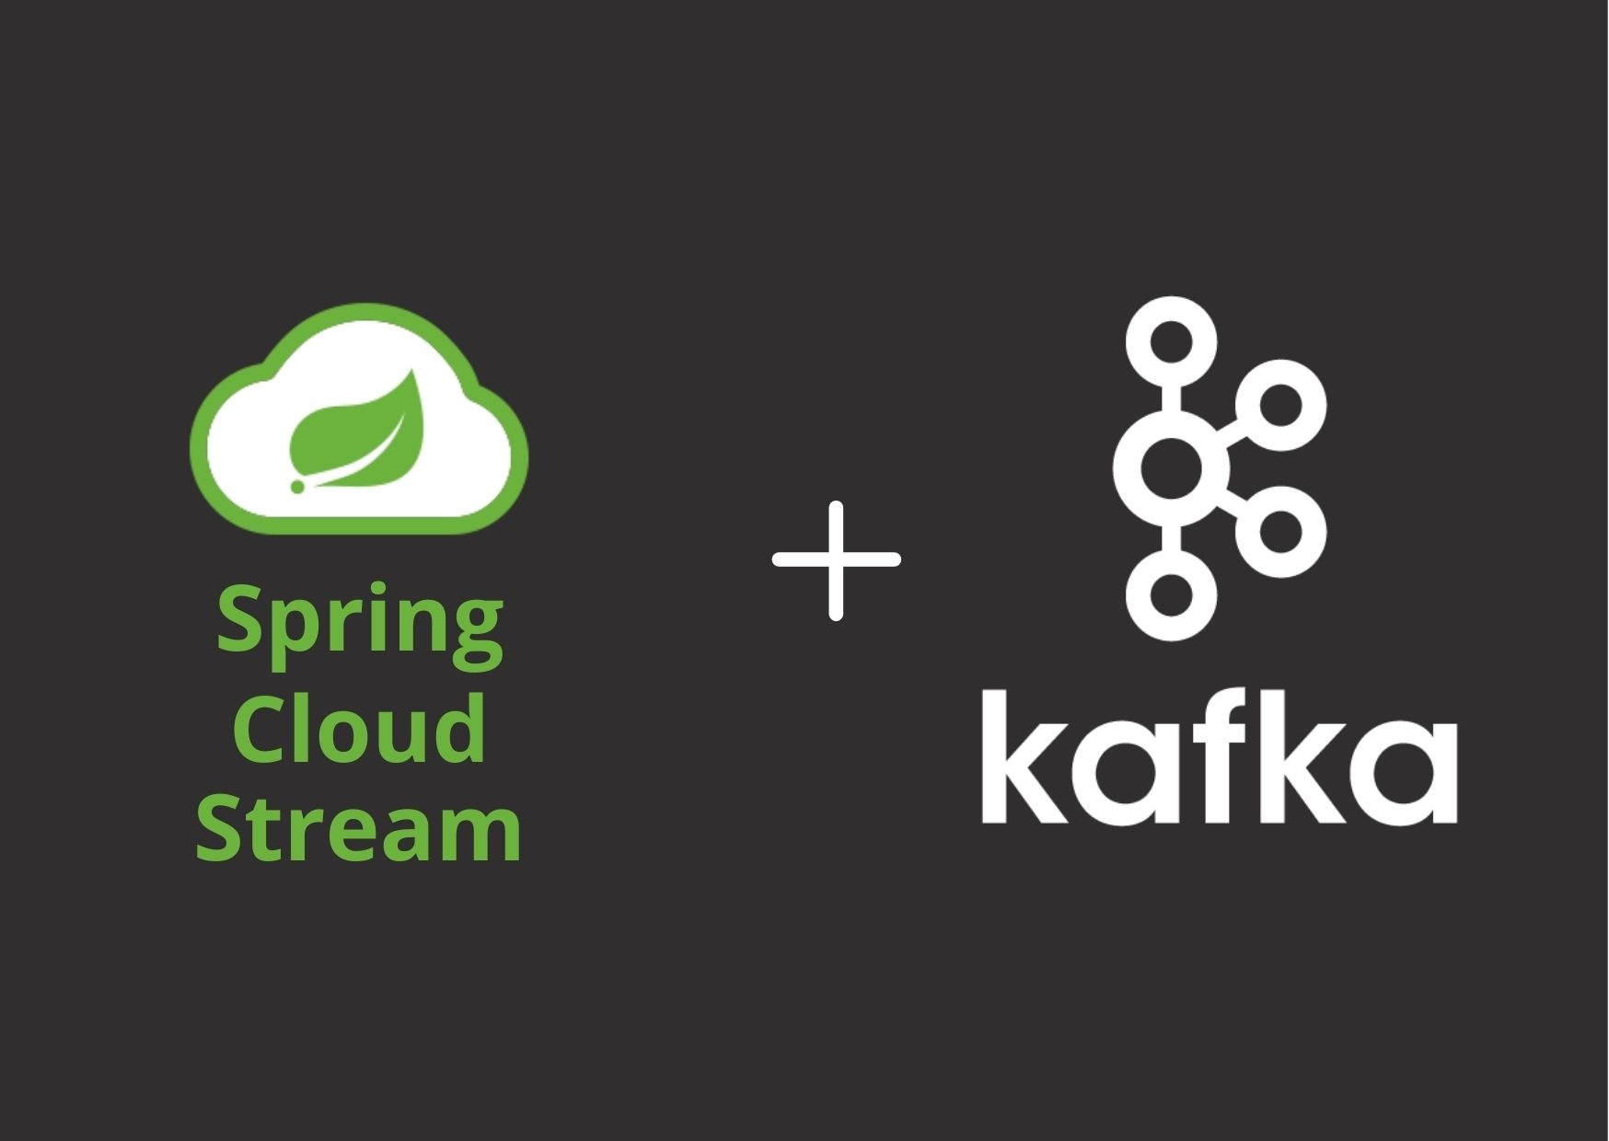
Spring cloud stream

Slide 14
Apache Kafka
Open-source stream processing platform
A distributed publish-subscribe messaging system
Written in Scala and Java.
Handling capacity is more than other messaging systems
Used to build real-time streaming data pipelines
Reliably passing a stream of records from one application to another
Can Store the records in a fault tolerant way

Slide 15
Advantages of Kafka
High Throughput
Can process messages at very fast speed.
Processing rates can exceed beyond 100k/seconds.
The data is processed in a partitioned and ordered fashion.
Scalability
Achieved at various levels.
Multiple producers can write to the same topic.
Topics can be partitioned.
Consumers can be grouped to consume individual partitions.
Durability
Offers data durability as well, message written in Kafka can be persisted.
The persistence can be configured.
This ensures re-processing, if required, can be performed.

Slide 16
ZooKeeper
Zookeeper
Distributed, open-source, configuration, synchronization service
Also naming registry for distributed applications
Kafka needs Zookeeper.
It uses Zookeeper to track status of its cluster nodes, topics, partitions etc.

Slide 17
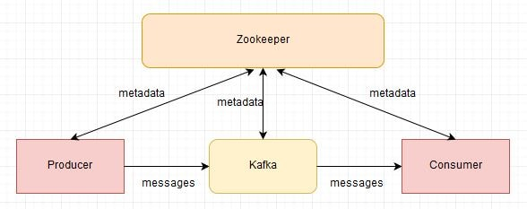
Apache Kafka
.

Slide 18
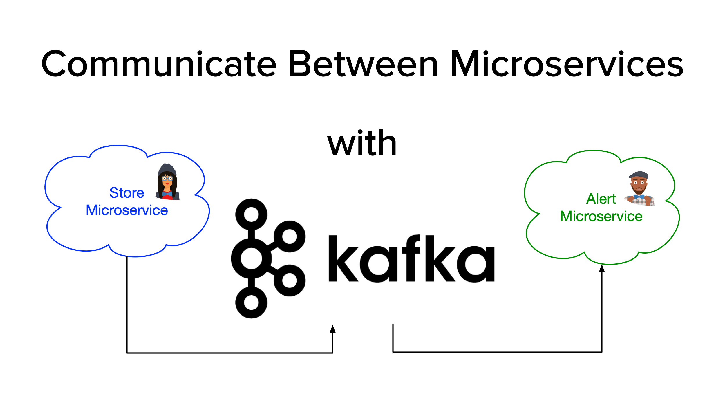
Micro Services
Two microservices — Producer and Consumer.
The producer will accept a Json Object through a REST endpoint and publish to a Kafka topic.
Consumers will subscribe to the topics.

Slide 19
Topics
Kafka Clusters stores/retrieves the records in Topics.
Topic is a stream at rest.
Like a table in a database or folder in a file system.
Decouples producers and consumers.
Consumer pulls messages from a topic
Producers push messages into a Kafka topic.
A topic can have many producers and many consumers.
Each record in the topic is stored with a key, value, and timestamp.

Slide 20
Binding
In the Functional Model, the default binding is created with the method name
Binding are created as follows
javaMethodName-in-<index>
javaMethodName-out-<index>
index corresponds to the index of the application instance.

Slide 21
Spring Boot Starter Project
Create Spring Boot Starter Project with following Dependencies
Cloud Stream
Spring for apache kafka
Spring web

Slide 22
Model Class
public class Payment {
Long id;
Long bookingId;
double paymentAmount;
LocalDate paymentDate;
String status;
public Payment(Long id, Long bookingId, double paymentAmount, LocalDate paymentDate) {
this.id = id;
this.bookingId = bookingId;
this.paymentAmount = paymentAmount;
this.paymentDate = paymentDate;
}
}

Slide 23
StreamBridge
Spring Cloud Stream abstraction
Used to send messages from any binding,
Can use any Underlying messaging system.
It’s a Spring bean, that can be autowired
streamBridge.send("my-destination", new Message("Hello, world!"));

Slide 24
Producer
@RestController
@AllArgsConstructor
public class ManagePaymentController {
@Autowired
private StreamBridge bridge;
@PostMapping(path = "/payment")
public ResponseEntity<String> sendMessage(@RequestBody Payment entity) {
boolean result =bridge.send("info-topic", entity);
return ResponseEntity.status(HttpStatus.CREATED).body(entity.toString());
}
}

Slide 25
Consumer
@Configuration
public class LoanApplicationConsumer {
@Bean
Consumer<LoanApplication> loanConsumer() {
return application -> {
System.out.println(application);
};
}
}

Slide 26
application.yml
server:
port: 9001
spring:
cloud:
stream:
bindings:
consumer-in-0:
destination: approve-topic

Slide 27
Caching in spring boot

Slide 28
Caching
Caching is a part of temporary memory -RAM
To store data for future reference.
Between the application and persistence database.
Stores the recently used data to reduce the number of database hits as much as possible.
Data access from memory is always faster in comparison to fetching data from the database.
Cache Declaration
It identifies the methods that need to be cached.
Cache Configuration
The backing cache where the data is stored and read from.

Slide 29
Caching With Spring
Spring Framework provides caching in a Spring Application
The cache abstraction is a mechanism that allows consistent use of various caching methods with minimal impact on the code.
The Spring abstraction layer can use cache independently of the cache provider.
Supports the Caching Providers
EhCache
Hazelcast
Couchbase
Redis
Simple

Slide 30
Caffeine
Caffeine is the fastest, most feature-rich in-memory, local caching for single Java application instance.
Spring Boot automatically detects the Caffeine library on the classpath,
Add to the pom.xml
Spring's CacheManager defaults to using Caffeine
Distributed Caching (Redis, Memcached)
The cache runs as a separate, dedicated cluster of servers external to the application.
spring.cache.type=caffeine
spring.cache.cache-names=products

Slide 31
Configure HazelCast
@EnableCaching
Will start the search for a Cache Manger bean to configure the cache provider.
Caching implementation is done in the Service Layer
@Cacheable:
@CacheEvict:
@CachePut:

Slide 32
@Cacheable
@Cacheable can be applied to @Service
It is a method level annotation, starts the cache support.
Takes two attributes value and key
Stores using the key-value
Cache will search for the value by the key.
If the value is found in the cache, and the method will not be executed.

Slide 33
@Cacheable
Value:
To specify the name of cache and is required, Multiple cache names can be supplied by using a String array
Key
This is the key with which objects will be cached. SpEL expression is used
@Cacheable(value="posts", key="#postId")
public Post findById(Integer postId) { }
Can apply a condition by using the condition attribute.
@Cacheable(value="student", condition="#name.length<20")
public Student findStudent(String name) { }

Slide 34
@CacheEvict
Used for removing stale or unused data from the cache, since cache can grow quite large and may be holding unused data.
Can be applied on delete and update methods
Deletes the data from the cache.
Can define the key that is used to identify the cache item that should be deleted.
Can delete all entries from the cache
@CacheEvict(value = "emp", allEntries=true)

Slide 35
@CachePut
It is used to update the cache without interfering the method execution.
Method will always execute, and its result will be placed into the cache.
@Cacheable , skips the method execution
@CachePut runs the method and put the result into the cache.
@CacheEvict when you're deleting an object.
@CachePut(value = "cars", key = "#car.id")
public Car update(Car car) {

Slide 36
Example
@Cacheable(cacheNames = "driver",key = "#id")
public Optional<Driver> findById(long id) {
return this.repo.findById(id);
}
@CachePut()
public Driver update(Driver entity) {
return this.repo.save(entity);
}
@CacheEvict(value="driver", key = "#entity.id")
public void delete(Driver entity) {
this.repo.delete(entity);
}

